Slide 1
Building Digital Communities
Getting Started

Slide 2
What is digital inclusion —and why does it matter?
Digital inclusion is the ability of individuals and groups to access and use information and communication technologies.
Digital inclusion encompasses not only access to the Internet but also the availability of hardware and software, relevant content and services; and training for the digital literacy skills required for effective use of information and communication technologies.
Digital Inclusion is important to every aspect of Society

Slide 3
What does digital inclusion mean for people in a community?
Digital inclusion means that:
• All members understand the benefits of advanced information and communication technologies.
• All members have affordable access to high-speed Internet-connected devices and online content.
• All members can take advantage of the educational, economic, and social opportunities available through these technologies.

Slide 4
Not all members of a community benefit equally, and some communities have been left out altogether
Recognizing the cost to American competitiveness in a global economy, Congress directed the Federal Communications Commission (FCC) to develop a plan to ensure that every American has “access to broadband capability.”
March 2010, the National Broadband Plan recommended that the Institute of Museum and Library Services (IMLS) take the lead in supporting libraries and community-based organizations as they improve digital inclusiveness
– These Slides are based on the Guide developed through collaboration from over one hundred organizations and experts.

Slide 5
A framework for community-wide planning
Communities across the country are recognizing the pressing need to coordinate, plan for, and implement digital inclusion. These efforts include:
Extending broadband infrastructure to rural and underserved areas
Increasing Digital Literacy
Developing Programs to ensure everyone can complete online job applications
Take Distance learning classes
Manage his/her health care

Slide 6
A framework for community-wide planning
Digital inclusion is needed for building healthy and prosperous communities across all important sectors—
economic and workforce development
education
health care
public safety and emergency services
civic engagement
social connections

Slide 7
While each community will have different priorities, the fundamental needs are the same:
high-speed infrastructure to carry Internet traffic and connect households to businesses and community institutions
help people learn to navigate technology and provide a safe environment for doing so;
maintain public options for those who are unable, can’t afford, need temporary access, or for whom it doesn’t make sense to maintain private access;
remove barriers to access for people with disabilities or facing other obstacles to access; and
address the special needs and requirements of key sectors that drive the local economy

Slide 8
Complete Engagement
A community must engage all sectors to achieve digital inclusion.
Government
Individuals
Local and tribal governing bodies
Businesses
Non-profit organizations
Special Interest Groups
Other stakeholders
Public Libraries have a key role in bridging the digital divide. **

Slide 9
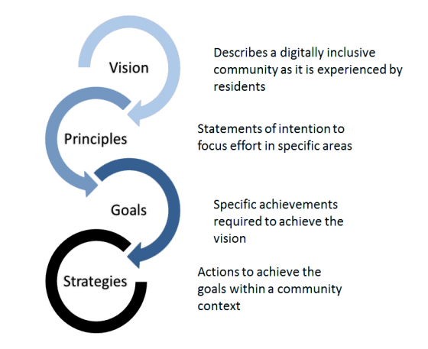
The Framework
The Framework consists of four components:

Slide 10
Access Principles
Access principles address the infrastructure a community needs to have in place in order to provide opportunities to benefit from digital life.
Availability: A reliable communications infrastructure is the raw material for innovation, growth, and competitive engagement in today’s information-based world.
Affordability: Access to the Internet needs to be affordable for communities and their members to benefit from the expanded opportunities of digital life.
Design for Inclusion: People with disabilities, physical or cognitive differences, and differences in age-related capabilities, language, literacy or culture may face challenges using technology and participating in digital life.

Slide 11
Adoption Principles
Adoption principles look to overcome individual barriers that make use of broadband technology less likely, even when access is available.
Public Access: Public access to technology is necessary for community members who have little or no communication technology available in the home, need assistance to effectively use technology, or to supplement connectivity at home or in schools.
Relevance: Beyond having access to technologies, individuals, businesses, and institutions need to understand the relevance and benefits of using technology to achieve educational, economic, and social goals.
Digital Literacy: Digital literacy skills, including the ability to find, evaluate, and use information to achieve goals, are a necessary pathway to digital inclusion.
Consumer Safety: Consumers —both individual and institutional —need accurate, unbiased information on how to safely navigate the digital world.

Slide 12
Strategic Areas
The thoughtful deployment of broadband technologies in six specific strategic areas can strengthen communities and can improve the lives of their residents.
Economic and Workforce Development: Communities need to develop the knowledge and skills of future workers and entrepreneurs, as well as help the current workforce update its competencies to meet the needs of employers.
Education: Educational institutions should ensure that students have the digital skills to reach their full potential by connecting them to a diverse range of electronic resources.
Health Care: Efficiencies and cost-savings in health care delivery, improvement to patient care, and support for independent living and management of health concerns are all enabled by access to broadband and digital technology.
Public Safety and Emergency Services: Residents and first responders need integrated communications systems for emergency and disaster preparation, response, and recovery.
Civic Engagement: Electronic interaction between community institutions, government agencies, and individuals creates enhanced opportunities for active participation in community affairs.
Social Connections: Individual members of a community should have access to technologies that promote social engagement and the pursuit of independent learning and creative interests.

Slide 13
Stakeholders?
Local City, county, and tribal governments
Public Agencies
Libraries
Schools
Higher Education
Museums
Public Housing departments
Non-Profit Community- based Organizations
More flexible than many government based organizations
Linked to specific communities and targeted populations
Often provide job placement, help to low-income families and other support

Slide 14
1. Who Are the Stakeholders?
Business Community
Major employers
Telecommunication companies
Can help with job and economic growth
Provide internet hot-spots
Support community initiatives
Residents
Individuals that represent a community / associations
Resident participation on committees and task forces, collecting data, providing workshops, volunteers

Slide 15
2. Develop a shared understanding of digital inclusion
In an area as complex as digital inclusion, community stakeholders need to begin with a shared understanding of the needs and the goals
What does the term digital literacy mean for the community?
What digital technologies are currently available, and to whom?
Where are the gaps? Who is left out and at risk of being left behind?
What are the most important community goals of digital inclusion: economic development, education, job training, health care, emergency management, social connection?

Slide 16
3. Create a community action plan
Grounded in the shared vision, communities need to develop an actionable plan that outlines specific goals, measures of success, timelines, and assignments of responsibility
Some communities will make large comprehensive plans; others will create more narrowly targeted plans that utilize their limited resources as effectively as possible.

Slide 17
4. Implement the plan
Drawing on government appropriations, business contributions, philanthropy, or combination of sources, communities will need to develop the mechanisms necessary to generate the resources required to execute the plan.
Plan will need to be promoted, maintain momentum and allow stakeholders to provide mutual support, encouragement and accountability.

Slide 18
5. Evaluate and Revise the plan
Digital devices and transmission capabilities, workforce requirements, economic drivers, and population demographics are all constantly changing
As circumstances change, implementation plans must change as well.

